Slide 1

CDNK Medical
Indian Trail Improvement District (ITID) – Board Hearing
April 16, 2025

Slide 2

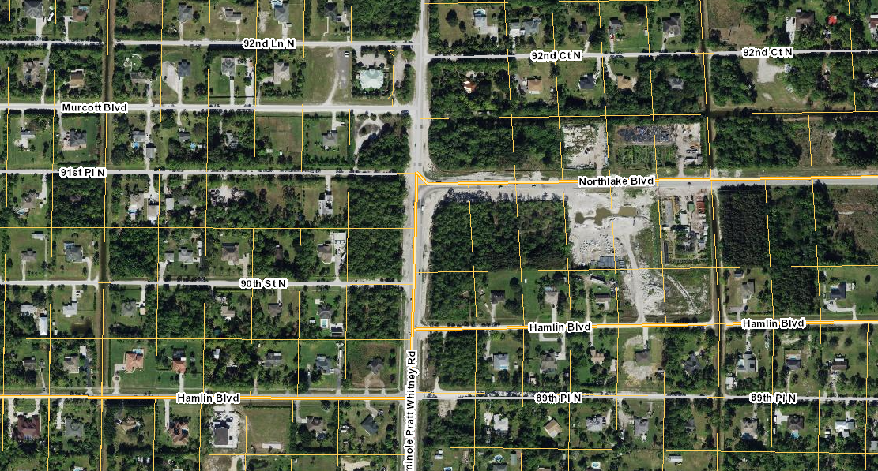
PROJECT LOCATION
2
Site: 3.38 Acres
Zoning: AR (Proposed CLO)
FLU: RR-2.5 (Proposed CLO w/underlying RR-2.5)

Slide 3
PROPOSED COMPREHENSIVE PLAN TEXT AMENDMENT REVISIONS
3
Exurban Office - Policy 1.3-j: In order to allow transitional uses on Seminole Pratt Whitney Road adjacent to the commercial node at the intersections of Orange Boulevard and Northlake Blvd, the County shall allow exceptions to location criteria for low-intensity office uses that have a residential or rural design and appearance. The ULDC shall be revised to incorporate this new “Exurban Office” as a subcategory of Commercial Low Office Zoning, and shall establish a minimum of a DRO approval for all uses allowed within this zoning on sites utilizing this policy. (Ord. 2020-022)
Property Requirements. Properties that do not meet the Exurban Tier Commercial Location Criteria in Policy 1.3-f may apply through the future land use amendment process for a Commercial Low-Office (CL-O) future land use designation subject to the following:
Is an adjacent lot, as defined by the Introduction & Administration Element, to existing Commercial Low future land use or a lot eligible for a Commercial Low future land use;
Has legal access to Orange Boulevard, 69th Court North, 70th Street North, 71st Street Lane North, 71st Place North, and 72nd Road North, or is located between 90th Street North and 91st Place North; and
Has a lot depth of no greater than 300 feet west of Seminole Pratt-Whitney Road. (Ord. 2020-022)
Design Requirements. The development of the CL-O sites subject to this policy shall be residential in scale, be comprised of a single building, and designed with
architectural and landscaping features that enhance the rural character and preserves and protects The Acreage’s unique rural lifestyle as recommended by the Acreage
Neighborhood Plan, and shall comply with the following:
Minimum 50-foot building setback from a residential property line;
Minimum 15-foot landscape buffer along all residential property lines;
Preserve a minimum 25% existing native vegetation on site
The building front façade and primary entrance shall not face Seminole Pratt Whitney Road, and enhanced landscaping and vegetative screening shall be provided on Seminole Pratt Whitney Road
Maximum 0.05 FAR, except for those properties located between 90th Street North and 91st Place North shall have a maximum FAR of 0.10, and
Not include drive through uses. (Ord. 2020-022)

Slide 4
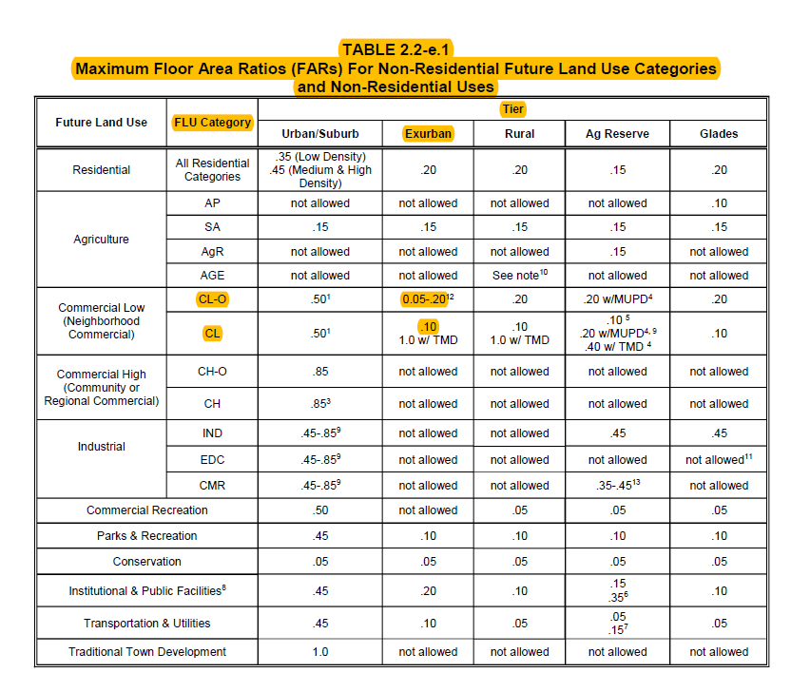
PERMITTED USES IN CLO & MAX. FAR
4
Permitted Uses in CLO:
Financial Institution
Medical or Dental Office
Business or Professional Office
Limited Access Self-Service Storage
Veterinary Clinic
Work/Live Space

Slide 5
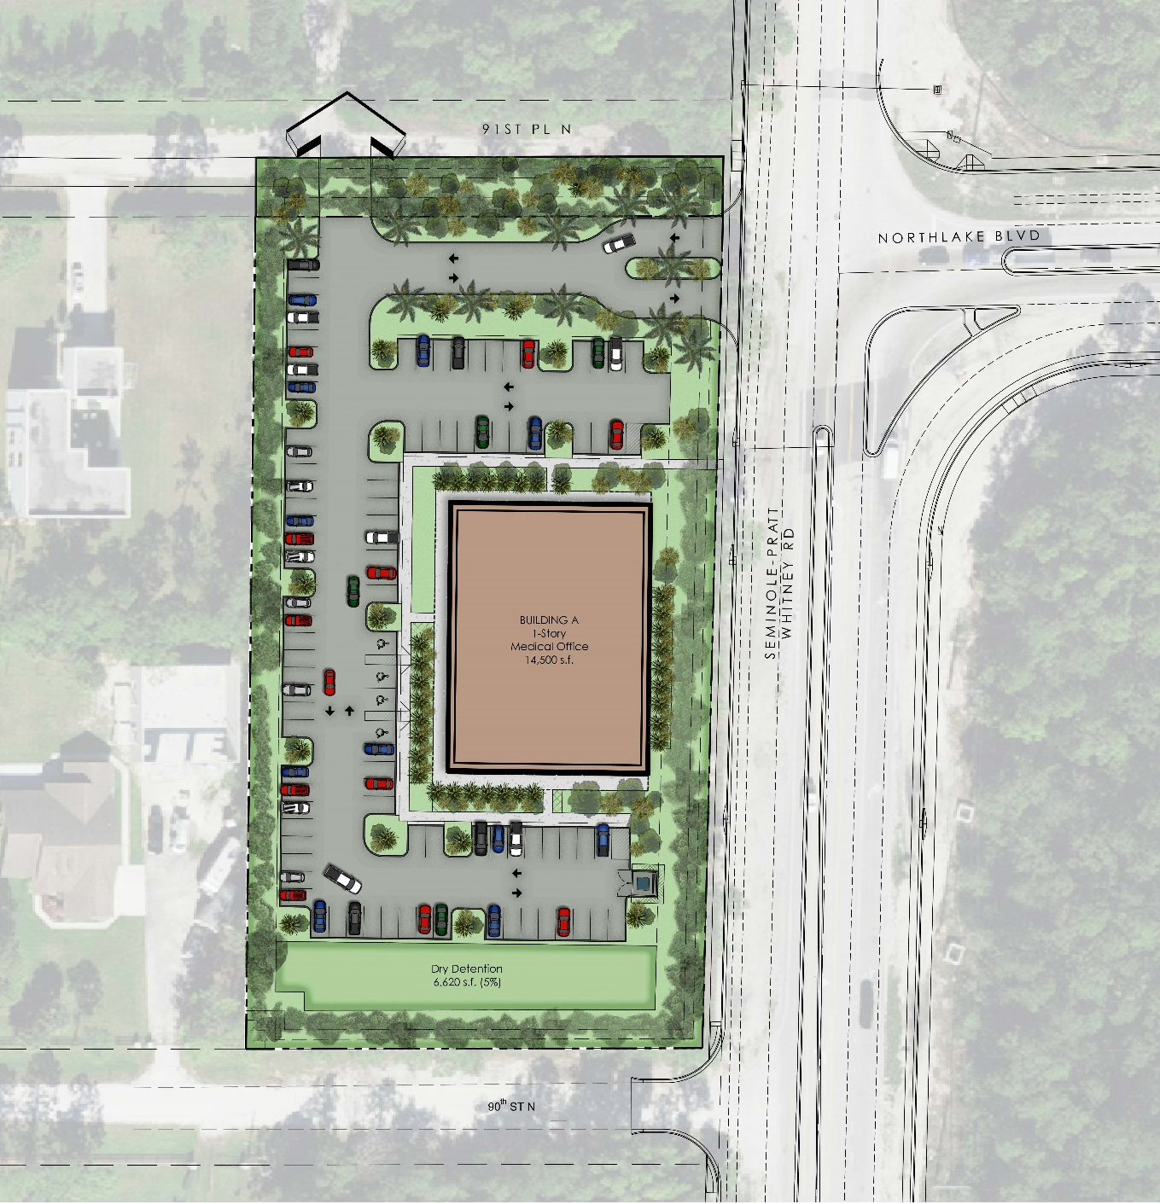
CONCEPT SITE PLAN
5

Slide 8

Question / Comment?
We respectfully request your support of the proposed application.

Slide 9
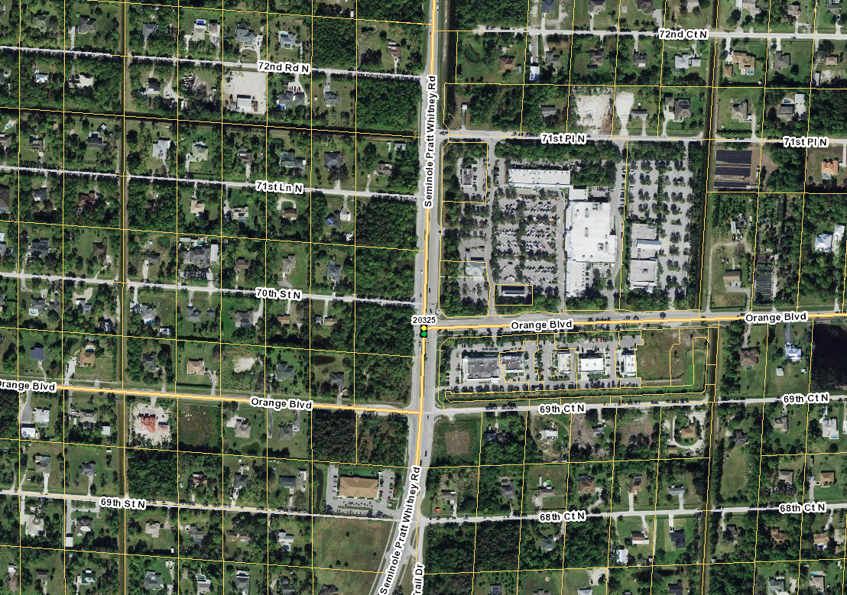


COMMERCIAL NODES
9
Seminole Pratt Whitney & Northlake
Seminole Pratt Whitney & Orange Blvd
72nd Road N
71st Place N
Northlake Blvd
71st Lane N
70th Street N
90th Street N
Orange Blvd
Seminole Pratt Whitney Road
Orange Blvd
69th Court N

Slide 10
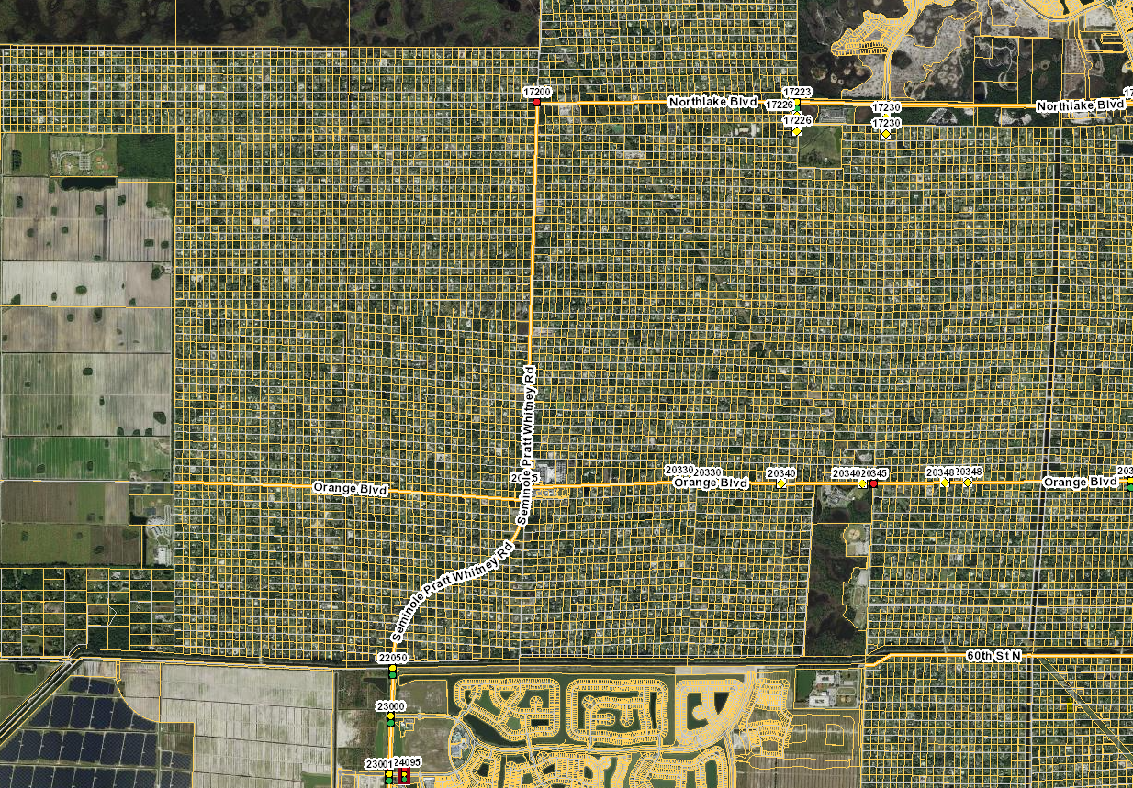
CONCEPT SITE PLAN
10
SITE
91st Place N
90th Street N
+/- 2.5 Miles
72nd Road N
71st Place N
71st Lane N
70th Street N
69th Court N
Westlake

Slide 11
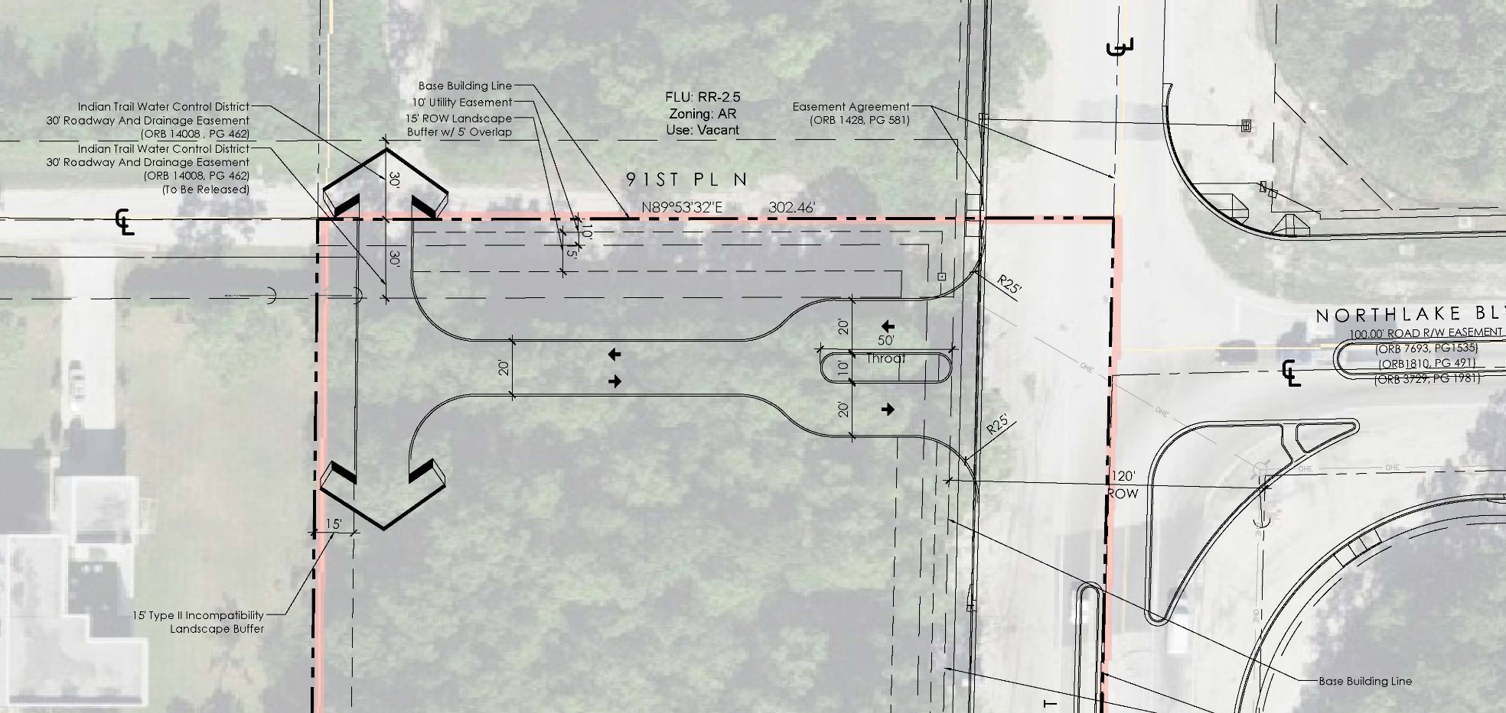
CONCEPT SITE PLAN
11

Slide 12
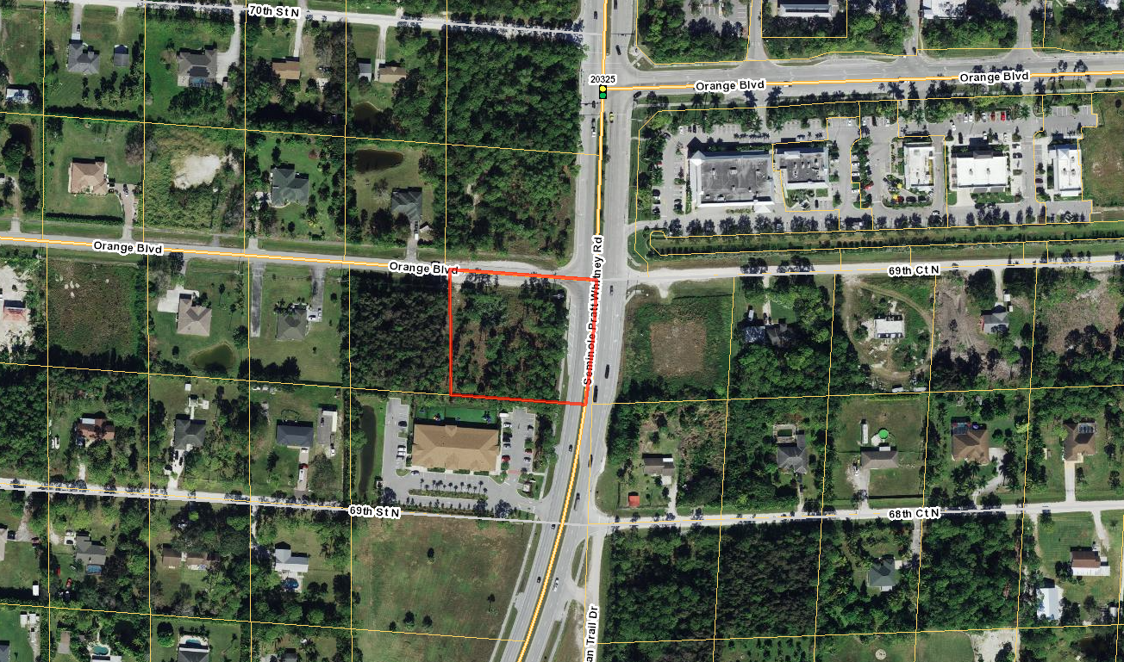

REACH ESTATE (ORANGE BLVD & SEMINOLE PRATT) – July 2020
12
Site: 1.76 Acres
Zoning: CLO
FLU: CLO w/underlying RR-2.5

Slide 13
ELIGIBLE PARCELS
13
Eligible Parcels for
Proposed Policy 1.3-J Revisions

